Slide 1

Unit 3: Op-Amp Applications
Sample & Hold circuit, Analog multiplier
Pre – preparation: Lecture Materials and LIC Text book by ROY Choudhury, sixth edition, 2022.

Slide 2

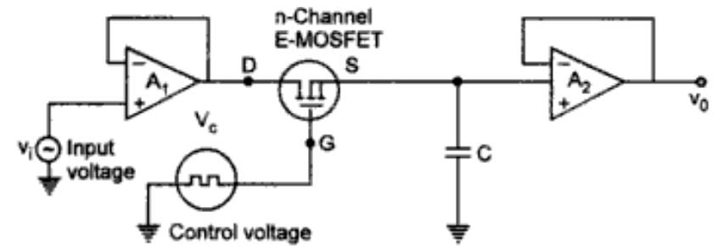
Sample and Hold circuit
A Sample and Hold circuit samples an analog input voltage, holds that value constant for a period of time.
During sampling:
During hold:
The MOSFET in the circuit acts as the sampling circuit. The frequency of the control voltage VC determines the sampling frequency.
The first amplifier acts as a simple voltage follower for the input signal.
The control voltage to gate of MOSFET dictates the status of MOSFET ON/OFF.

Slide 3
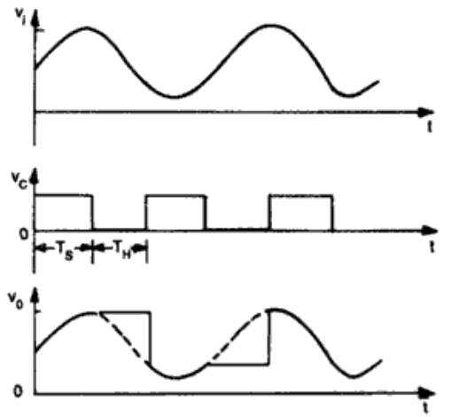
Sample and Hold circuit
When Vc is positive, MOSFET is ON.
Capacitor charges with time constant (R0+rds)C. The entire input waveform appears at non-inverting terminal of Op-amp2.
When Vc is negative, MOSFET is OFF. Since, Rin of Op-amp is very high the capacitor holds the previous charge with output staying at the voltage on capacitor.
For a proper sampling of the signal, the control voltage frequency should be atleast twice the input signal frequency.
Applications of sample and hold circuit include ADCs, Pulse Amplitude Measurement, digital oscilloscopes etc.

Slide 4


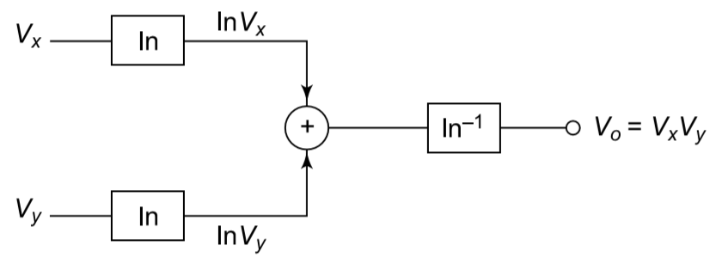
Analog Voltage Multiplier
There are multiple configurations for an Analog voltage multiplier.
One of the ways is log-antilog configuration. The outputs of log amplifiers are summed together.
The circuit operation is based on the logarithmic identity.
Since operational amplifiers can accurately add voltages, multiplication becomes practically realizable after converting signals into logarithmic form.
The summed logarithmic voltage is applied to another transistor configured as an antilog amplifier.
For voltage division give the output of
log amplifier to a difference amplifier.

Slide 5
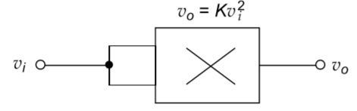
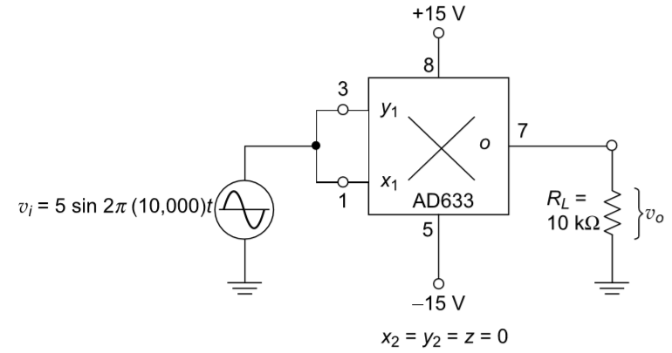

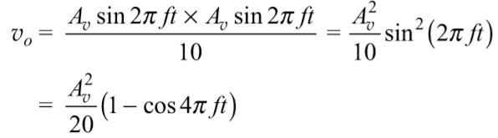
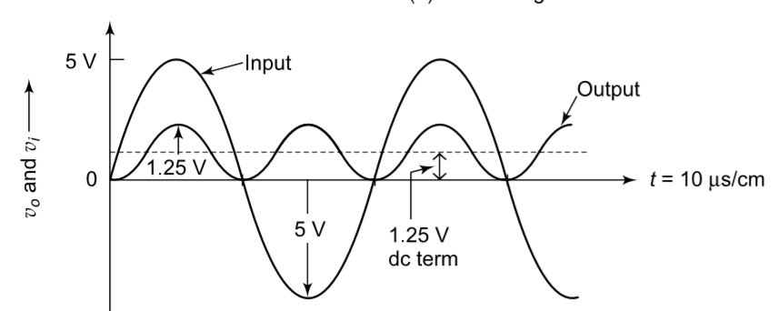
Applications
Voltage Squarer
For the above described multiplier configuration supply both the input voltages as equal signals.
Frequency Doubler:
The same voltage squarer when given with two signals of same frequency, the the output voltage turns out to be

Slide 6
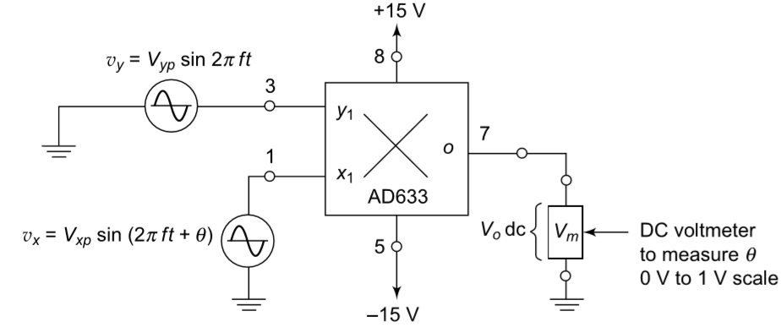
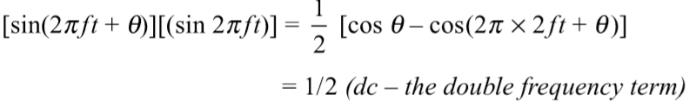
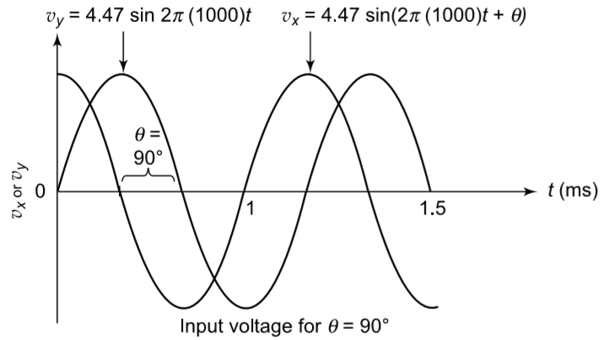

Phase angle detector:
When the inputs are given to the voltage multiplier with different phase angles the sinusoidal terms get multiplied.
The values of vxp and vyp represent peak amplitudes of input signals. A scaling factor of 10 is deployed for the multiplier configuration.
From the DC component, the phase can be calculated using phase angle meter.

Slide 7
Unit 4: Op-Amp Applications
Waveform Generators
Square, Triangle, Sawtooth
Pre – preparation: Lecture Materials and LIC Text book by ROY Choudhury, sixth edition, 2022.

Slide 8
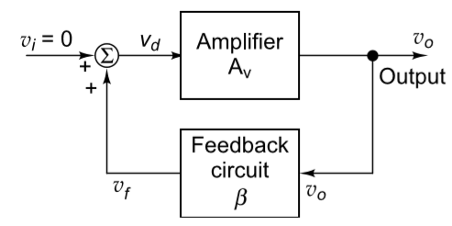
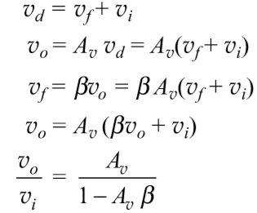

Waveform Generators
Operational amplifiers are commonly used to generate different types of waveforms such as sine, square, and triangular waves, which are required in electronic circuits.
Many analog and digital systems need periodic signals for purposes like timing, control operations, testing, and synchronization.
A sine wave is one of the most important and commonly used waveforms in electronics but generating an ideal sine wave with stable amplitude and frequency is comparatively difficult.
An oscillator is essentially a feedback amplifier. A portion of output is fed back to input to cause oscillations.
The condition for oscillations should be unity feedback gain with 0- or 360-degrees phase angle.

Slide 9
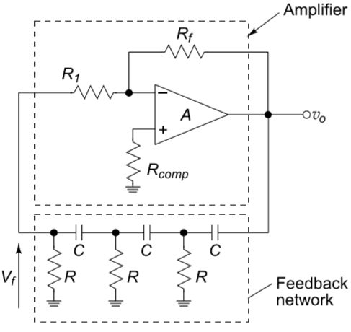
RC-phase shift oscillator
LC oscillators require large inductors at low frequencies hence RC networks are used for oscillator design.
Two commonly used RC oscillators are the RC phase-shift oscillator and the Wien bridge oscillator.
In an RC phase-shift oscillator, the op-amp is operated in inverting configuration, producing a phase shift of 180 degrees.
The feedback RC network provides another 180 degrees phase shift totaling a 360 degrees phase shift between input and feedback signal.
The feedback network determines the oscillation frequency, while the amplifier provides the required gain to compensate for losses occurring in the RC sections.

Slide 10

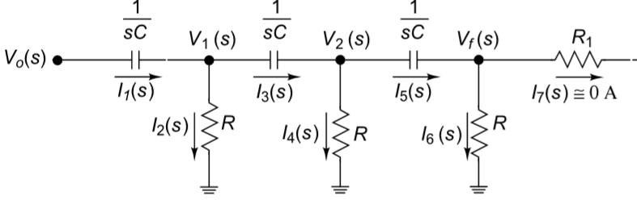



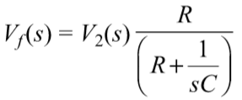



RC-phase shift oscillator

Slide 11




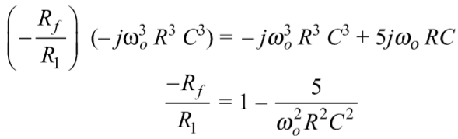

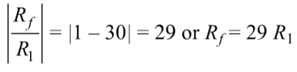
RC-phase shift oscillator
For RC phse shift oscillator gain should be 29 and frequency is oscillation is f₀

Slide 12
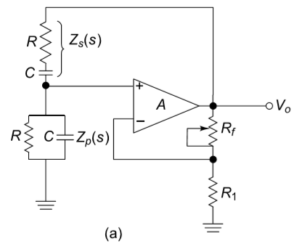
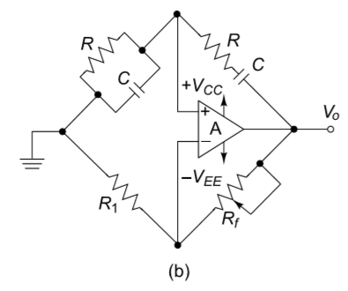
Wein Bridge Oscillator
Similar to RC phase shift oscillator wein bridge oscillator generate sinusoidal waveform when feedback phase shift and gain become 0 and 1 respectively.
This happens when the RC bridge is in balanced condition aka resonance condition
Wien bridge oscillator is an audio frequency sine wave oscillator of high stability and simplicity. It consists of balanced bridge used as feedback network.
The feedback signal in this circuit is connected to the non-inverting input terminal so that the op-amp is working as a non-inverting amplifier.Therefore, the feedback network need not provide any phase shift.

Slide 13
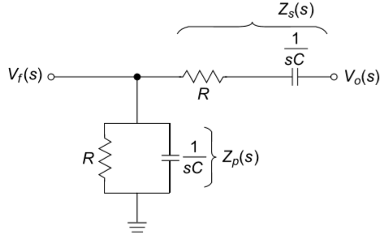





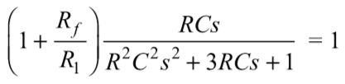

Wein Bridge Oscillator
Gain of Op-amp

Slide 14
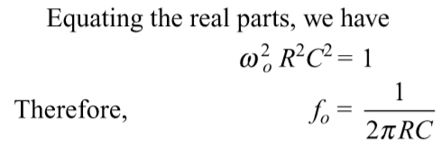
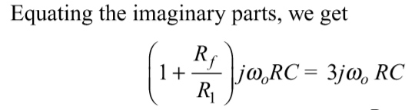

Wein Bridge Oscillator

Slide 15
Comparison
RC phase shift oscillator does not require closely matched components for resonance
Does not need special amplitude stabilization circuitry in basic operation.
However, it requires high gain and the phase errors tends to deviate a lot due to three RC sections.
Frequency tuning is difficult as three stages change phase if any RC value is changed.
Output amplitude is small and frequency stability is relatively low. Only suitable for low frequency applications
Wein bridge amplifier requires low gain and frequency stability is more with less distortion.
Frequency tuning is relatively easier with RC tuning.
However, the circuit design is complex and requires closely matched RC components.
Not suitable for very high frequency operations due to Op-amp bandwidth limitations.

Slide 16
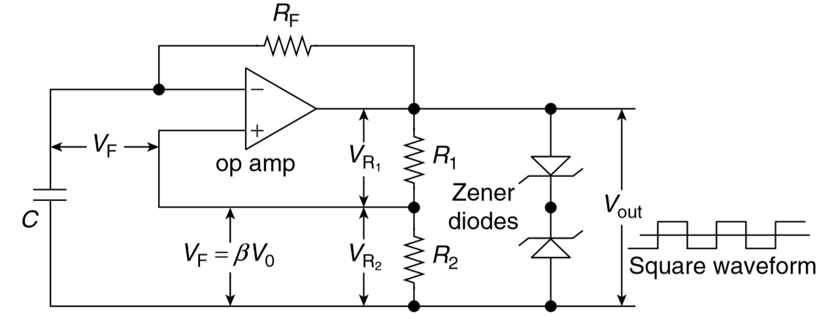
Square wave generator
A square wave generator generates a square waveform for digital applications.
It is also called astable multivibrator free running square wave.
The positive feedback is connected to positive terminal and the capacitor with feedback resistance are connected to non-inverting terminal.
The RF and capacitor network decides the pulse width of the square waveform.
The Zener diodes used at the output decide the output square wave amplitude.
The feedback network via R1 and R2 decides the threshold switching voltages.

Slide 17
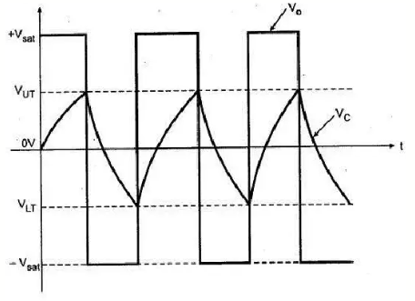
Square wave generator
Assuming the initial output as +Vsat, the potential at V+ becomes +Vsat(R2/(R1+R2)).
Since initial charge on capacitor is zero, the constant it charges towards the voltage +Vsat.
The charging time is decided by the feedback resistor RF and the capacitor C network and the switching thresholds decided by the positive feedback network.
When the charge of V- becomes more than V+, output flips to –Vsat.
Now capacitor discharges to –Vsat until the voltage of V- becomes more negative than V+ voltage (-Vsat x (R2/(R1+R2))). Once it happens output flips again.
The process continues creating a square waveform.

Slide 18









Frequency of oscillation
Continues until this point
For complete cycle we get

Slide 19
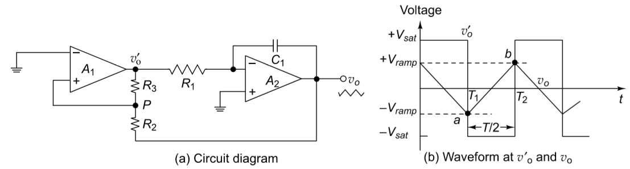
Triangular wave generator
The circuit contains two stages first a comparator followed by an integrator with R1 and C1 network.
The comparator compares the triangular waveform at its input with a reference level (usually ground). The output of comparator is either +Vsat or –Vsat.
The second stage integrates the input signal at the non-inverting terminal of Op-amp i.e., the output of comparator.
The output of comparator is a constant +Vsat or –Vsat. The integration of a constant generates a triangular waveform.

Slide 20

Triangular wave generator
Assuming initial v0’ as +Vsat, the capacitor charges to +Vsat with a constant current v0’/R
When the comparator output is –Vsat, the capacitor discharges with a constant current.
The frequency of oscillation for the triangular wave generator and the peak to peak amplitude depends on the resistors and the capacitors.
Applying a KVL from output V0 (Vramp) to output of comparator (+Vsat/-Vsat).

Slide 21

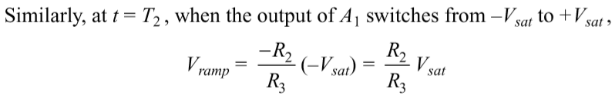
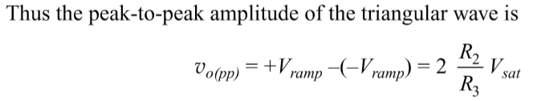

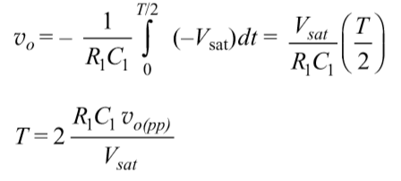

Slide 22


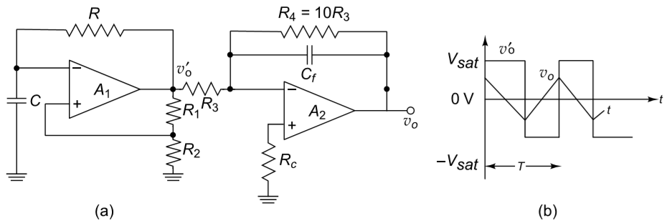
Equating bot equations we get:

Slide 23
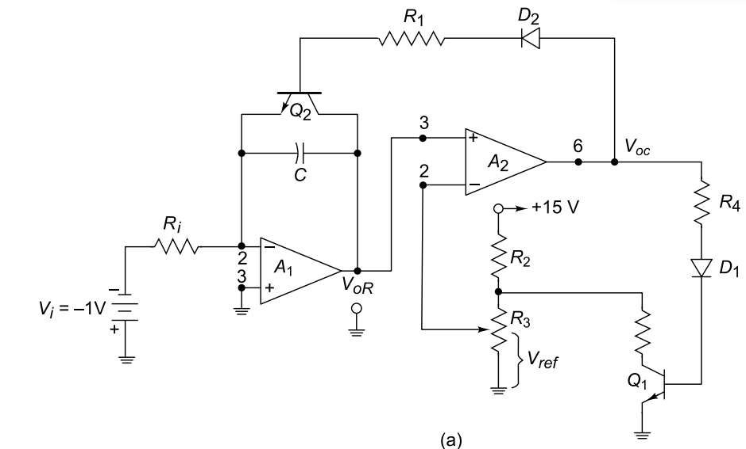
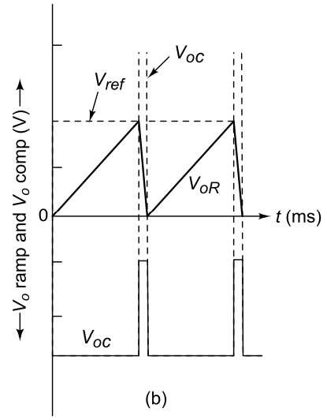
Sawtooth wave generator
A triangular waveform can be modified to build a sawtooth waveform generator.
A sawtooth waveform is similar to triangular waveform with smaller fall time and larger rise time.
The circuit contains two Op-amp stages.
The first an integrator stage and then a comparator.
A transistor is connected across the capacitor to act as switch for rapid discharge.
Resistances R2 and R3 provide the reference voltage for the comparator.
Diodes D1 and D2 avoid excessive reverse biasing to the transistors.

Slide 24


Sawtooth wave generator
Vi<0, V+=V- capacitor charges with current Vi/R1.
For Op-amp stage 2:
V+=V_{oR} and V-=V_{ref}
V+<V- so Voc=_Vsat.
D1 and D2 OFF
Q1 and Q2 OFF
V- remains at 15(R3/R2)
Q2 as open switch across capacitor and capacitor keeps charging and VoR keeps increasing.

Slide 25
Sawtooth wave generator
When VoR>Vref
A Voc=+Vsat
D1 and D2 ON
Q1 and Q2 ON (short circuit)
Capacitor discharges across Q2 rapindly reaching zero.
VoR goes to zero with C discharge.
V- of A2 reaches +Vsat(R/(R+R2))
At A2 V+<V-, O/p goes to –Vsat
Diodes and Transistors OFF
Capacitor again starts charging increasing VoR and process continues.

Slide 26
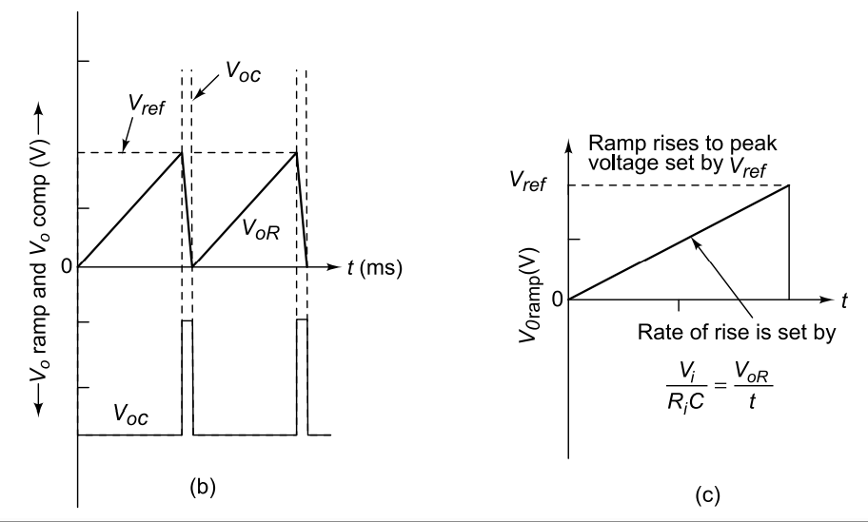

Slide 27
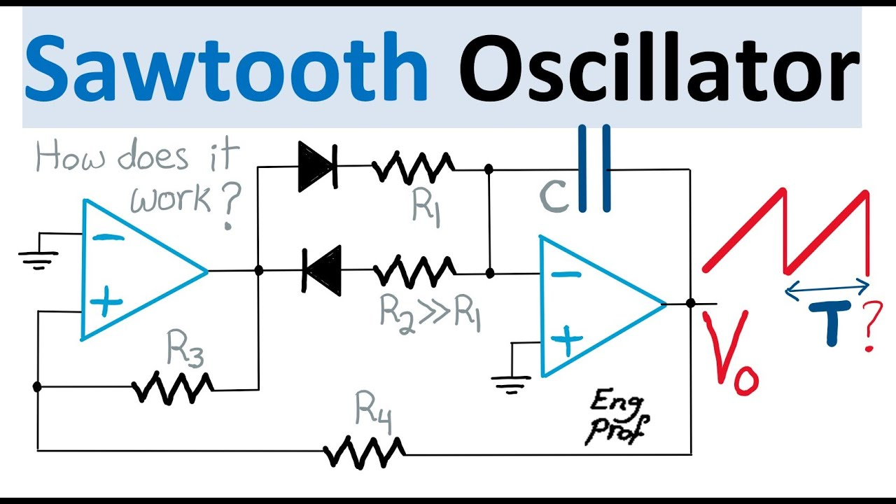
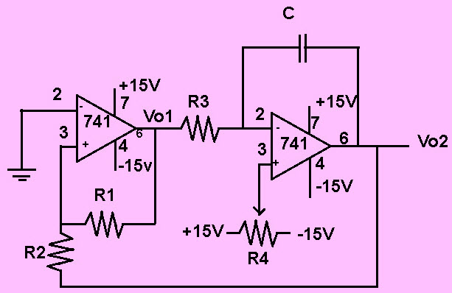

Slide 28
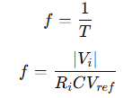



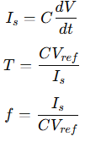

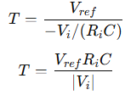
Frequency of oscillation

Slide 29
Applications of Sawtooth wave generator
Function generator used in testing and calibration.
Signal processing as reference signal in synchronization
Time-Base Generator in CRO / Oscilloscopes. The horizontal sweep in oscilloscopes requires a linear ramp voltage.
Sawtooth generators act as linear time reference generators.

Slide 30
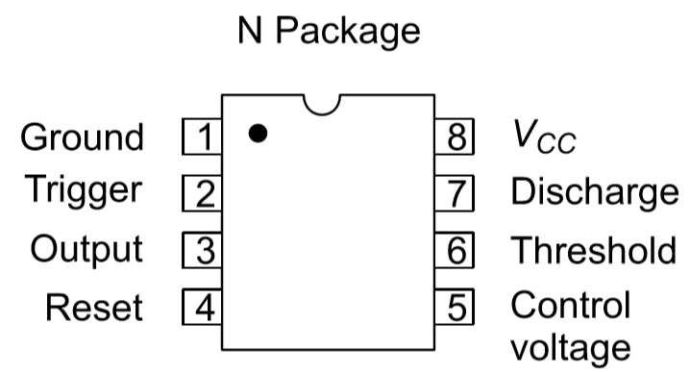
IC 555 Timer
The positive supply connected to pin 8 (VCC) and the negative supply to pin 1 (Ground), while the output at pin 3 can switch between a HIGH level (≈ VCC−0.5 VV_{CC}-0.5\,VVCC​−0.5V) and a LOW level (≈ 0.1 V).
The internal operation is based on two comparators monitor input voltages and control the internal flip-flop state.
Internal voltage divider: The voltage divider arrangement with resistors arrange for the threshold voltages for upper and lower comparators with 2/3Vcc and 1/3Vcc.
The control voltage pin is used for external modulation of reference levels and generally bypassed with 0.1uF capacitor to remove noise.
Pins 2 and 6 act as trigger and threshold pins to change the state of output.
Trigger operation sets output to high when the voltage at pin2 reduces below 1/3 Vcc.
When at pin 6 voltage increases by 2/3 Vcc the output state goes high resetting the flipflop forcing Q to zero.
The reset pin (pin 4) can force the output LOW when its voltage drops below 0.4 V. while the internal discharge transistor 𝑄1Q1 ​ connected to pin 7 conducts when the output is LOW to discharge the external capacitor and turns OFF when the output is HIGH.

Slide 31
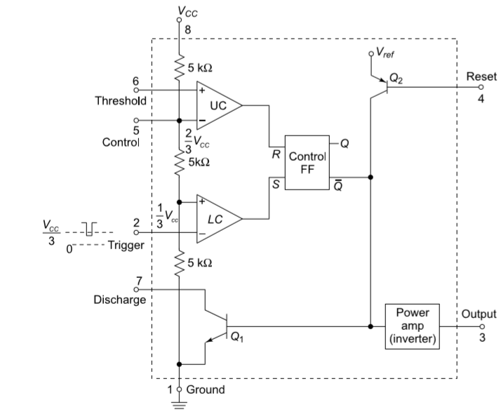

Slide 32
Monostable Multivibrator
Monostable multivibrator has one stable state and one quasi-stable state. It is also known as monoshot or one-shot multivibrator or uni-vibrator.
It remains in its stable state until an input pulse triggers it into its quasi-stable state. It stays in quasi-stable state for a time duration determined by an RC timing circuit.
Post RC time o/p returns to standby or stable state.
The circuit is built by connecting a resistor between pin 8 and pin6.
A capacitor is connected to pin 7 and shorted to pin 6. This RC network decides the pulse width or time constant of the pulse.

Slide 33
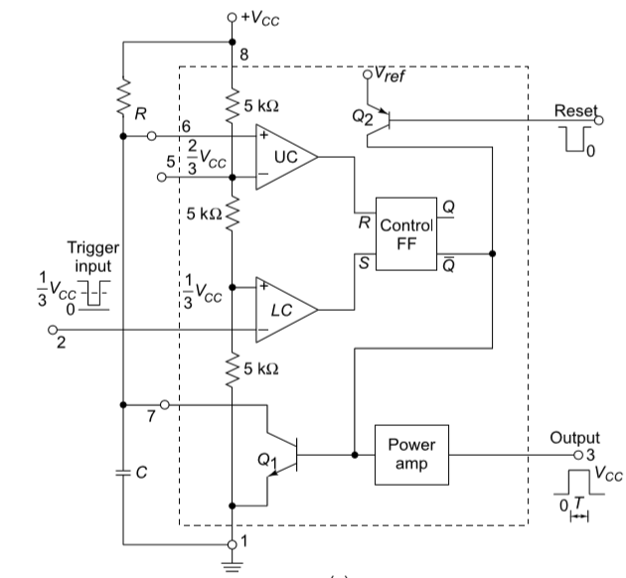
Firstly UC and LC are given with 2/3 voltage for V- and 1/3 voltage for V+ respectively with voltage divider arrangement.
Pin number 2 is held at a voltage higher than 1/3Vcc.
Initially the output of flipfop is 0 making Q_{bar}to 1 and Q1 ON.
The output of 555 timer is logic 0 or zero volts at output.
Now LC provides O/p logic zero since pin2 is more than 1/3Vcc
Since capacitor initial charge is zero, UC also provides output logic zero.
The flipflop retains earlier state as 0

Slide 34
Now a small trigger of potential less than 1/3Vcc is applied at pin2
LC shifts output to +Vsat aka logic 1.
The UC still maintains logic zero at output as charge on capacitor is still zero.
SR flipflop with S=1 and R=0 makes Q=1
This makes Qbar=0 and Q2 OFF
Output of 555 times is logic high or saturated voltage at output.
Since Q1 off the capacitor is unclamped and starts to charge.
The capacitor charges via the resistor R connected to pin8.

Slide 35
Now a small trigger of potential less than 1/3Vcc is applied at pin2
LC shifts output to +Vsat aka logic 1.
The UC still maintains logic zero at output as charge on capacitor is still zero.
SR flipflop with S=1 and R=0 makes Q=1
This makes Qbar=0 and Q2 OFF
Output of 555 times is logic high or saturated voltage at output.
Since Q1 off the capacitor is unclamped and starts to charge.
The capacitor charges via the resistor R connected to pin8.

Slide 36
When the charge on capacitor exceeds 1/3Vcc the LC shifts o/p to logic 0. This makes S of FF as zero.
When the charge on capacitor exceeds 2/3Vcc, then UC shifts o/p to logic 1.
The the FF has S=0 and R=1
This makes output Q=0 and Qbar=1 and Q1 ON
As soon as Q1 is ON, the capacitor clamps to transistor and discharges via the transistor to ground potential.
The output of 555 timer reverts back to zero.
This generates a pulse width of certain time period and then reverts back to its standby mode or stable mode hence monostable multivibrator.
The output remains zero until another trigger pulse is applied at pin 2.

